Slide 1

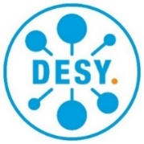








MADMAX
Towards a Dielectric Axion Haloscope
Erika Garutti
Universität Hamburg
On behalf of the MADMAX Collaboration

Slide 2
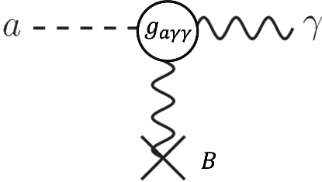

Open Dielectric Haloscope
MADMAX:
Tunable in frequency coverage:
~10-100 GHz
Boost emitted power through:
  coherent emission from multiple interfaces
  constructive interference effects
Coupling to g_{a𝛾𝛾} scales with:
  external field, ∝ B
  conversion surface, ∝ A^{0.5}
$$L < λ_{deBroglie}$$
Notes:
5/4 comes from the fact, that our SNR depends on 1/sqrt(Δν) ~ 1/sqrt(m_a) since the Δν comes from the doppler broadening at the frequency of the axion mass. This then goes inversely into C_aγ^2 and in the end g_aγ ~ m_a C_aγ ~ m_a * m_a^(1/4).

Slide 3
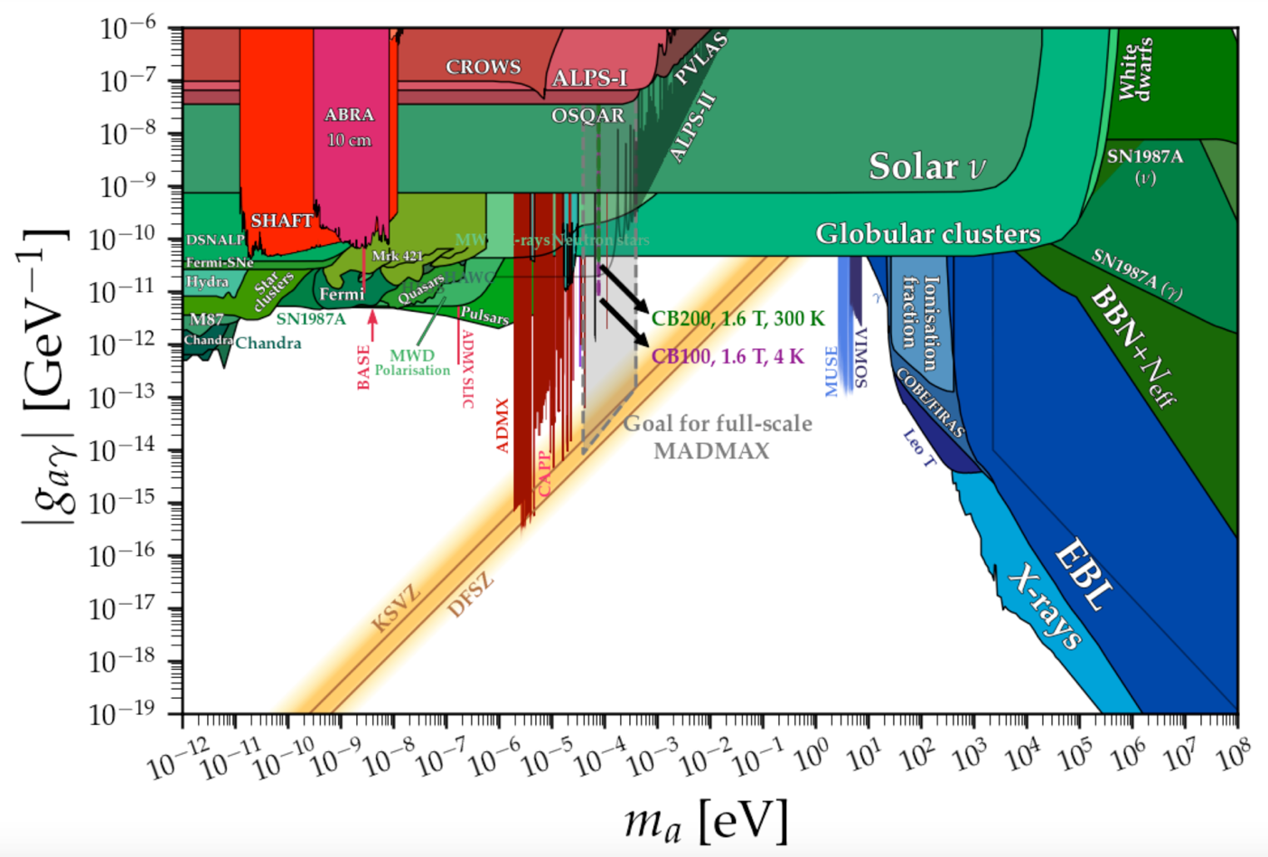





Open Dielectric Haloscope
MADMAX:
Tunable in frequency coverage:
~10-100 GHz
Corresponding to axion mass:
40-400 µeV
Coupling to g_{a𝛾𝛾} scales with:
  external field, ∝ B
  conversion surface, ∝ A^{0.5}
Plot from https://cajohare.github.io/AxionLimits/
axion photon coupling $g_{aγγ}$ [GeV⁻¹]
40 to 180 µeV
(post-inflationary scenario)
Nat. Commun. 13, 1049 (2022)
(https://doi.org/10.1038/s41467-022-28669-y)
cavities
dielectric haloscopes
$$P_{total}$$
Power boost factor:
$$β^{2}=$$
$$P_{mirror}$$
axion mass $m_{a}$ [eV]

Slide 4
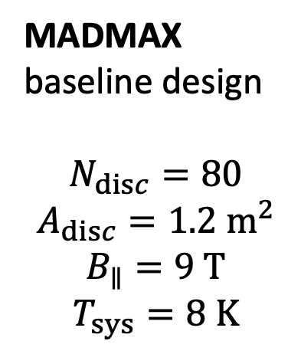
Open Dielectric Haloscope
MADMAX
baseline design
$$N_{disc}=80$$
$$A_{disc}=1.2 m^{2}$$
$$B_{∥}=9 T$$
$$T_{sys}=8 K$$
Feasibility studies
on prototype systems
Disk tiling, flatness alignment, …
Checked with MACQU
Require prototype tests in a cryostat
axion photon coupling $g_{aγγ}$ [GeV⁻¹]
axion mass $m_{a}$ [eV]

Slide 5
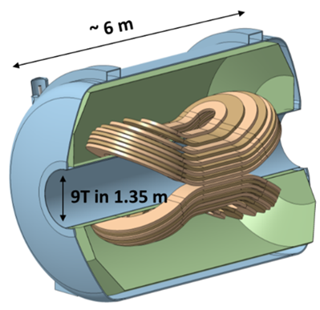
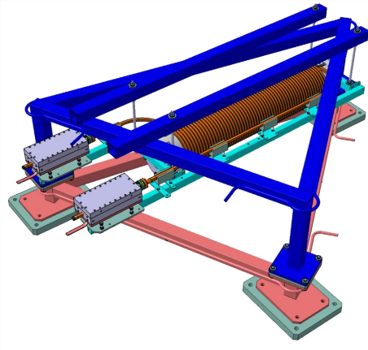

MADMAX Magnet Update
Dipole Magnet most critical item for full-size MADMAX
Design for 9 T large bore conceptually very well advanced
Novel conductor: cable in copper conduit
➔ production is feasible
Quench propagation velocity was measured in
dedicated setup: MAdmax Coil for Quench Understanding
➔ Main project risk mitigated: Quench propagation according to requirements for safe operation
MACQU
Quench propagation
Quench velocity
Development in innovation partnership
MACQU data
MACQU data
C. Loprin et. al
IEEE Transactions on Applied Superconductivity vol. 33 Issue 7 (2023) 1-11
simulation

Slide 6
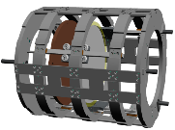
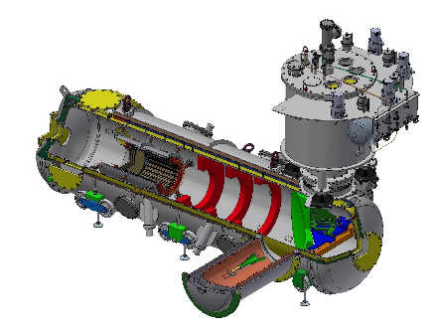
Staged Prototype Program
Closed Boosters (CB):
⌀ = 100 mm (CB100), 3 Al₂O₃ disks
⌀ = 200 mm (CB200), 3 Al₂O₃ disks
Aim:
First ALP run at ~19 GHz with system “easy to simulate”
Increase ALP sensitivity & understand scaling issues
➔ Understanding readout chain and RF behaviour
Open Boosters (OB):
⌀ = 200 mm (OB200), 2 Al₂O₃ disks
⌀ = 300 mm (OB300), 3 disks (Al₂O₃ & LaAlO₃)
Technical test of components (motors, interferometer, ..)
Proof-of-concept for MADMAX
➔ Establish boost factor calibration in an OB
Large bore (⌀ = 760 mm ) cryostat allows operation of all prototypes
Fits into the 1600 mm warm bore of
MORPURGO magnet at CERN
GOAL
MADMAX
Many disks with
large ⌀ ➔ tiled LaAlO₃
Boost dish antenna emission

Slide 7
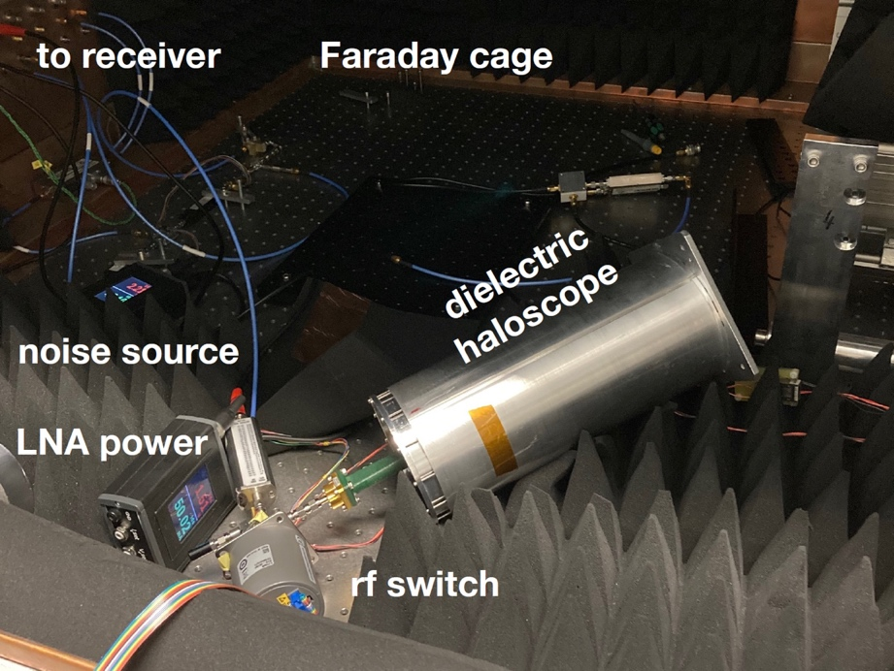
CB100: First ALP Search
Simple closed system to understand RF behaviour
Receiver
Parabolic taper
3x Ø100 mm disks (fixed distances)
Copper mirror
DAQ system
Closed Booster 100
Tested in MORPURGO
@ CERN
in 2022 and 2023

Slide 8
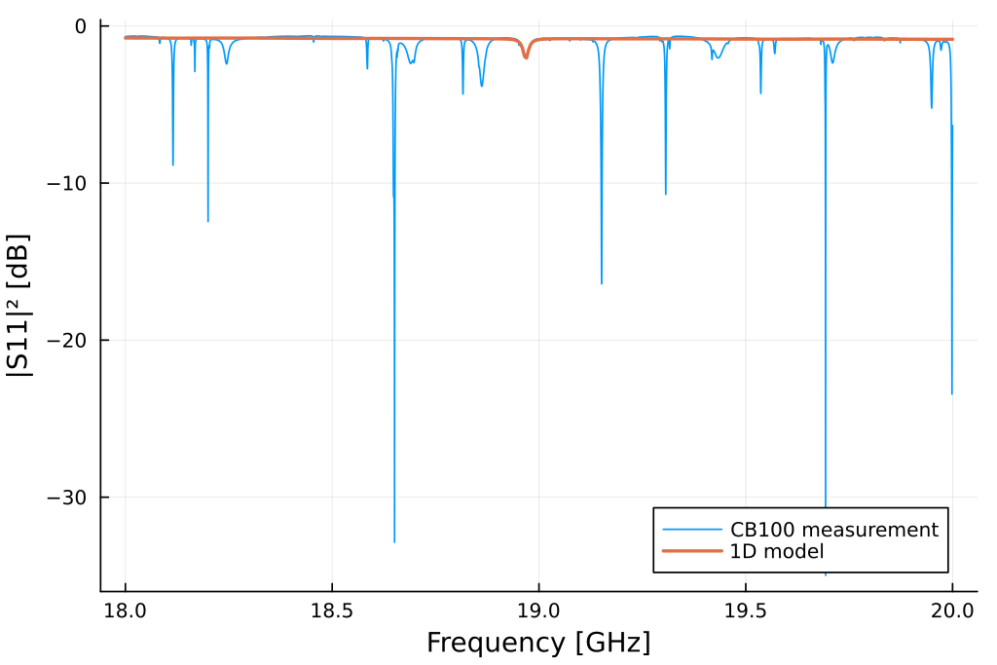
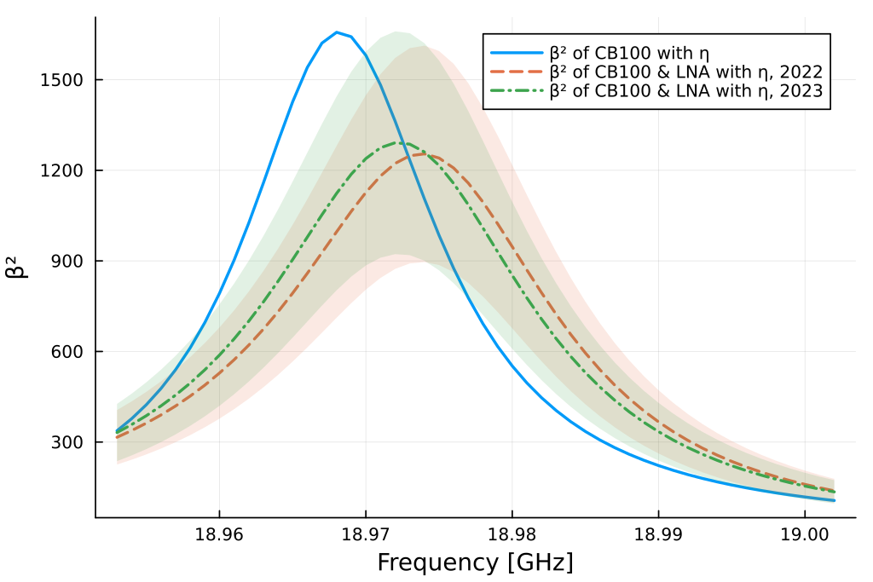
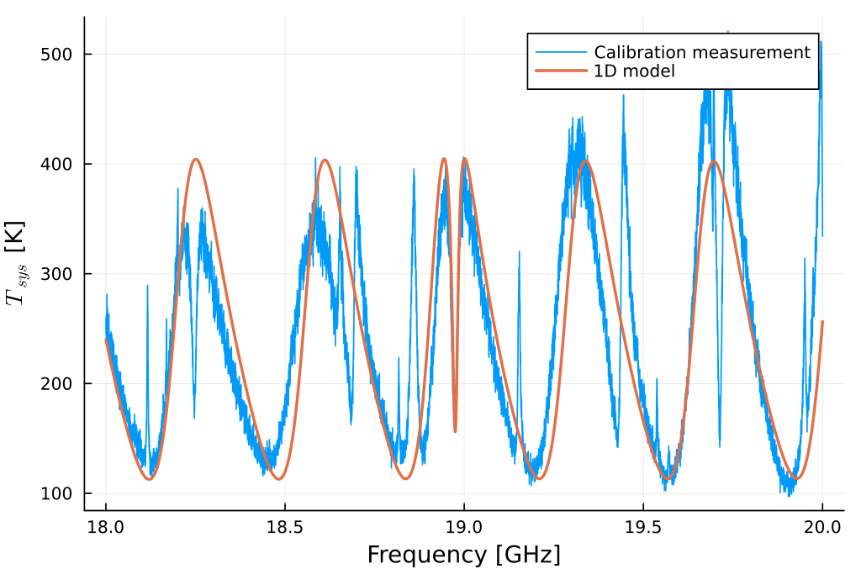
CB100: First ALP Search
Boost factor extracted from model tuned to data ➔
Boost peak
 | Q
CB100·η | 1185
(CB100+LNA)·η | 862
(CB100+LNA)·η | 903
RF response
η = coupling efficiency of axion to system
ADS simulation
2GHz SA meas.
Thermal noise
Consistent Boost factor in 2022 and 2023
Different LNA matching impedance: 25 Ohm (2022), 30 Ohm (2023)
➔ Data analysis ongoing

Slide 9
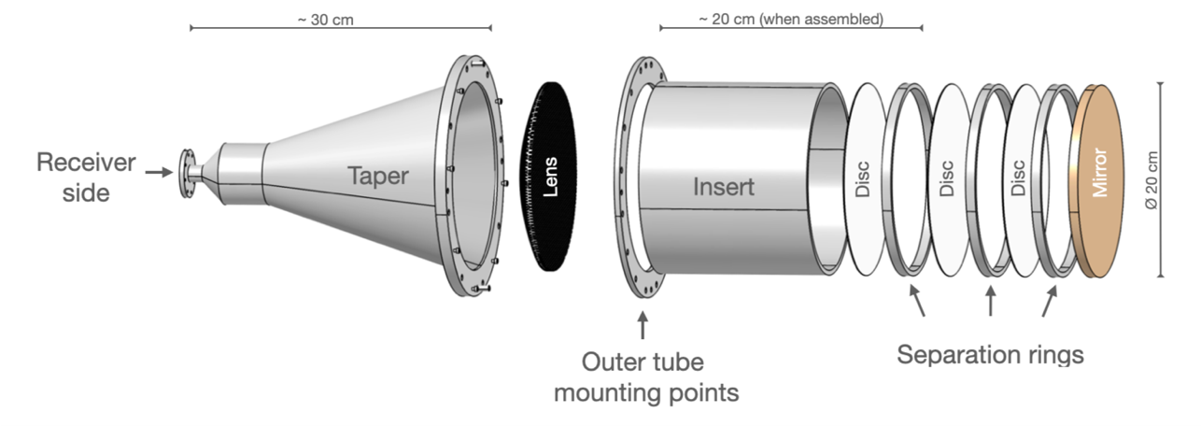
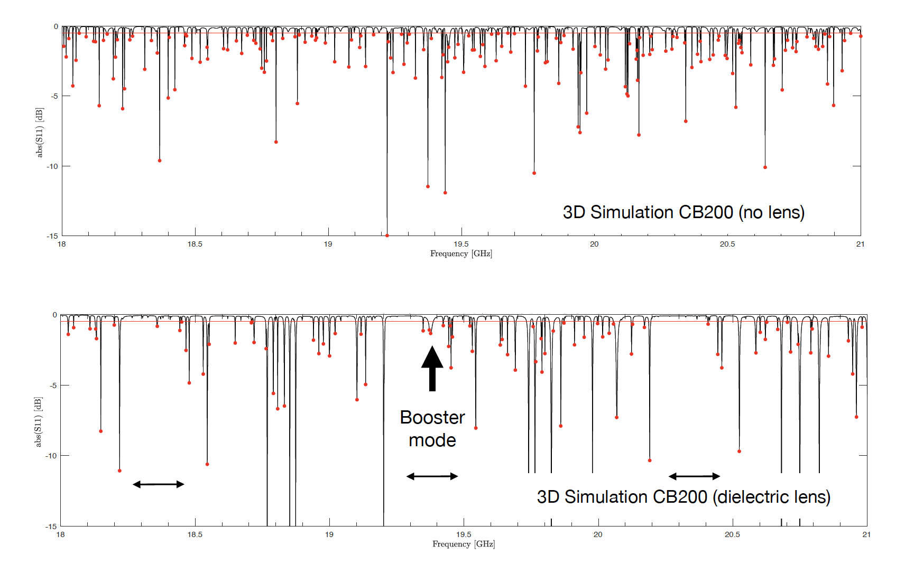
CB200: Understanding Scaling
Coupling to g_{a𝛾𝛾} scales with:
  conversion surface, ∝ A^{0.5}
Larger dimensions increase the number of allowed modes
➔ Learn to deal with overmoded systems
relevant for OB
➔Using a dielectric lens (Rexolite) decreases coupling of unwanted modes and allows for “quiet" regions in the spectrum
Notes:
Rexolite with a dielectric constant of 2.53 and low loss.
Maybe you can mention that it is 3d-printed and designed to mitigate reflection for our range of interest of ~18 to 20 GHz.
I have included the 3d model and a photo of the periodic structure, should people be more interested

Slide 10
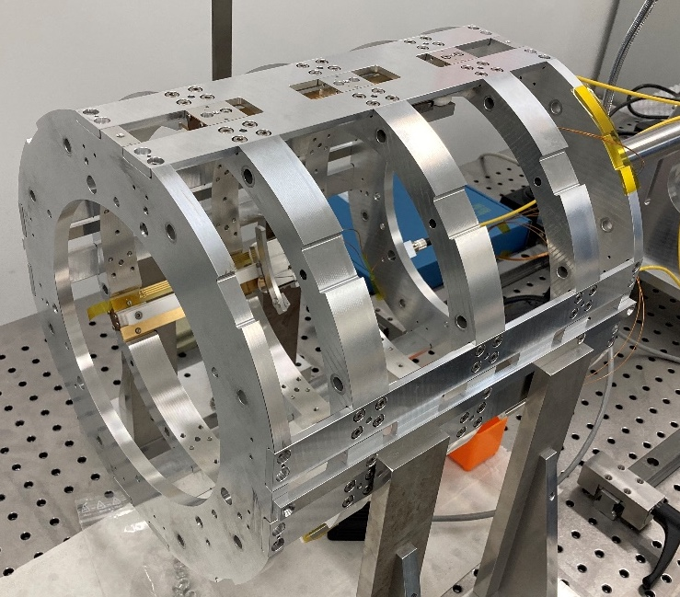
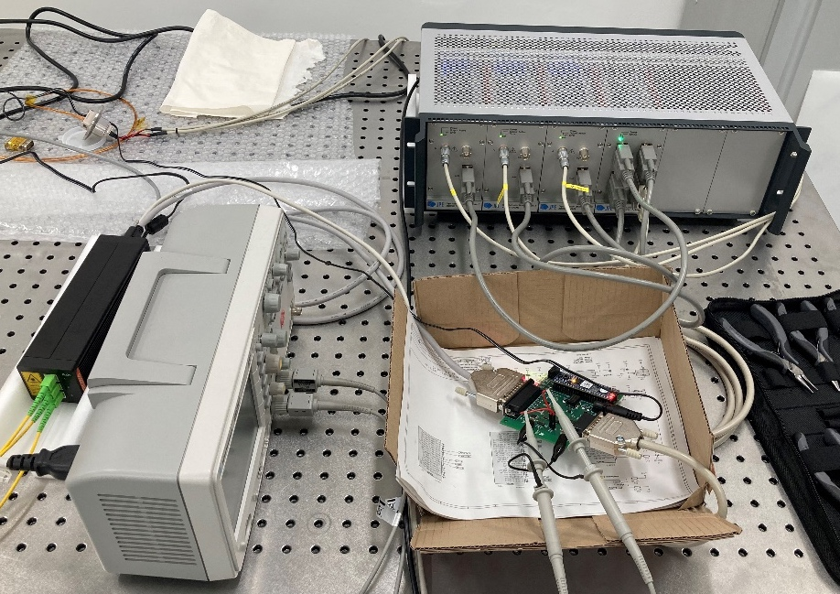

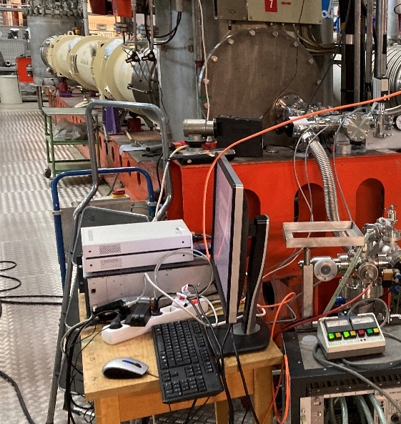
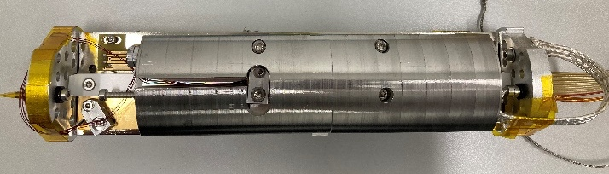

OB200: Technical Feasibility
OB200
Successful piezo motor tests
in cryogenics & inside ALPS II magnet
→ Motor works in 5.3 T field and at 5 K
arxiv:2305.12808
ALPS II magnet test stand
Laser interferometer
Piezo controllers
Mechanical demonstrator with:
One 200 mm sapphire disk in titanium ring + mirror
Three JPE piezo motors on self-built carriages
Piezo controller system for driving a disk with three motors
interferometer for displacement measurement
Motor velocity with/without B Field
Single motor test rig
➔ Successfully tested at CERN cryolab and at MORPURGO

Slide 11
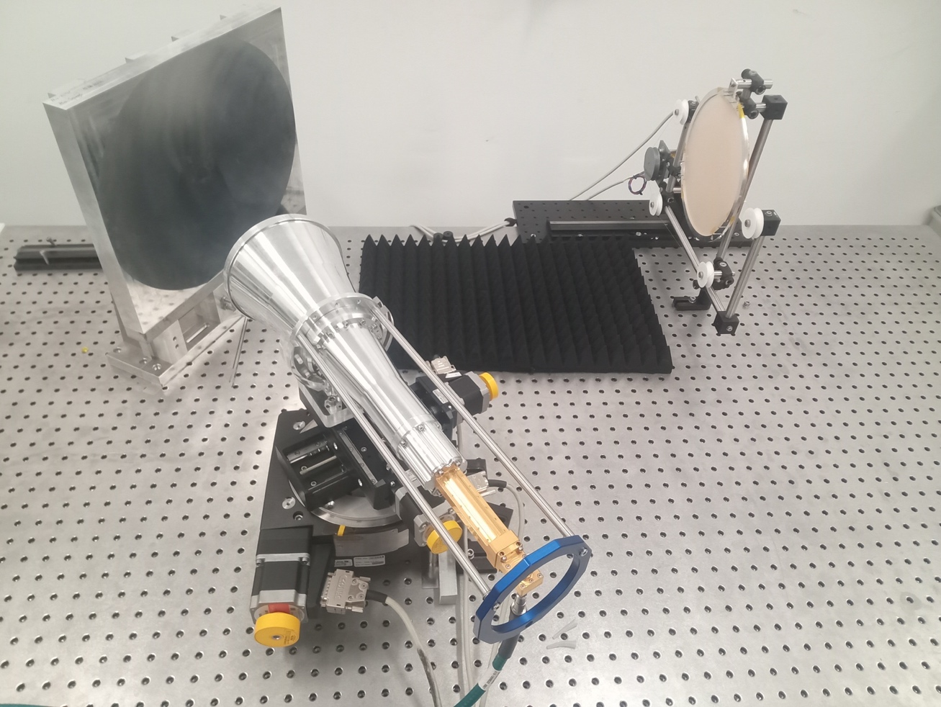
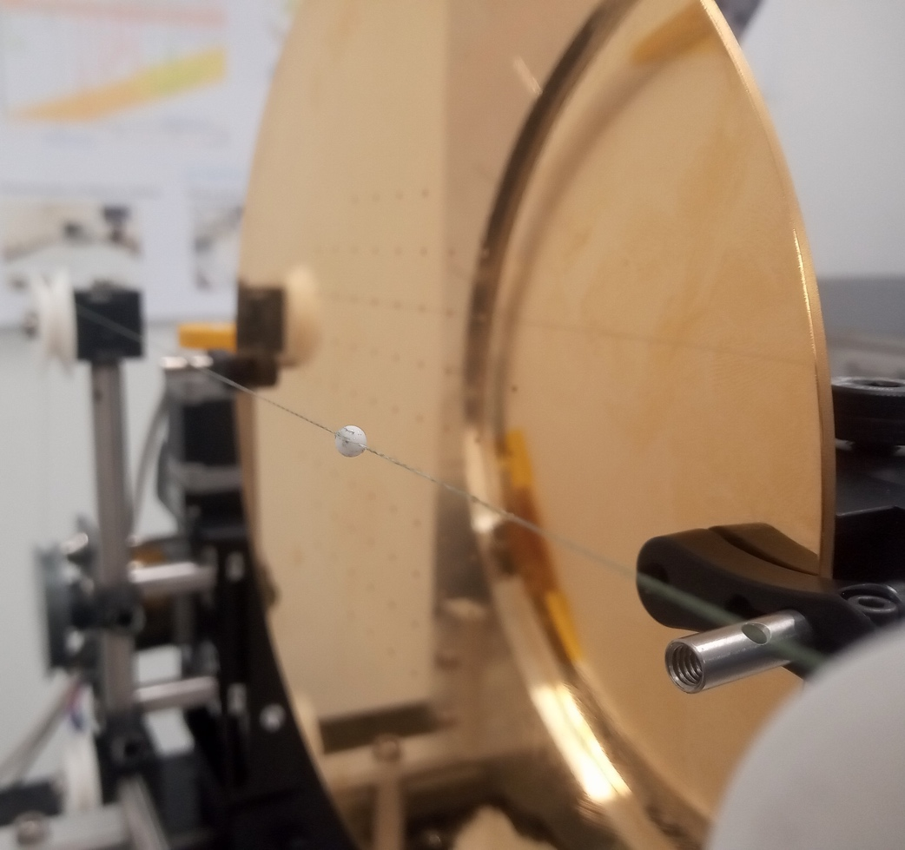
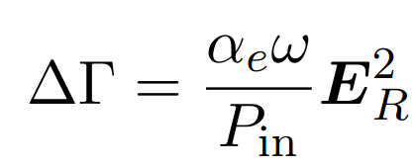
Open Booster Calibration
Boost factor determined using Bead Pull Method (non-resonant perturbation theory) + reciprocity theorem
Booster
(1 Disk and Mirror)
Focusing Mirror
Mirror
x
y
z
Alumina Bead
Antenna
Beed properties
Change in
reflection
coefficient
Electric
field
VNA
4
See poster by Jacob Egge

Slide 12
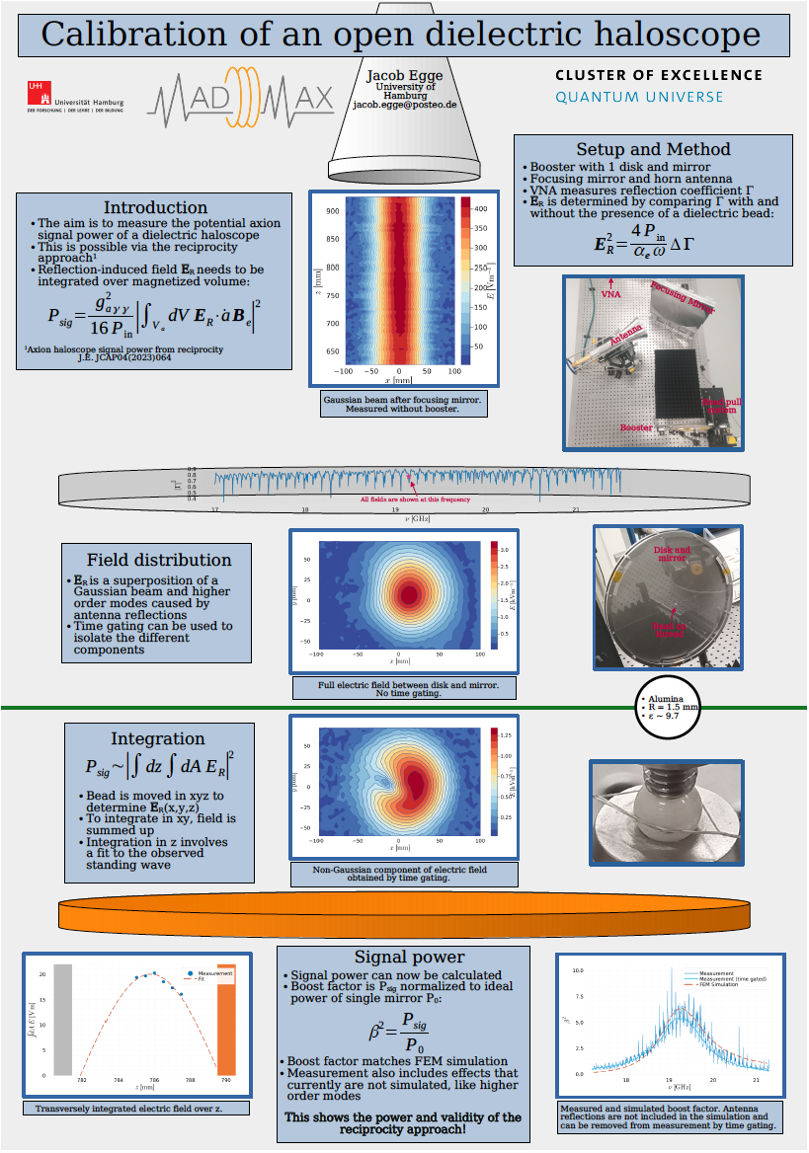
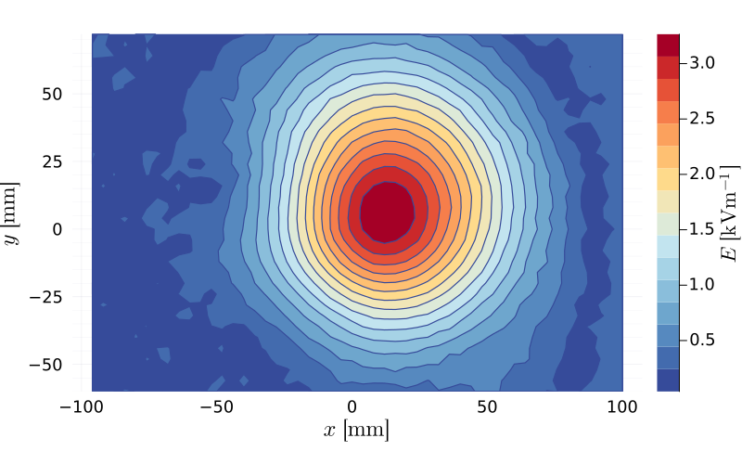
Open Booster Calibration
Mirror
Alumina Bead
Beed properties
Change in
reflection
coefficient
Electric
field
4
See poster by Jacob Egge

Slide 13
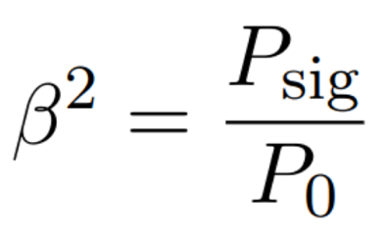
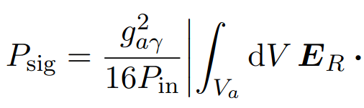

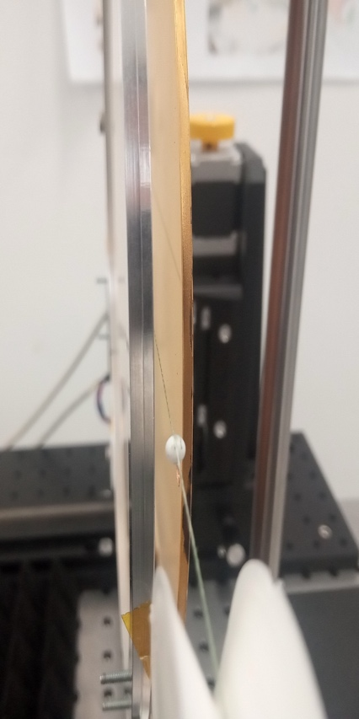
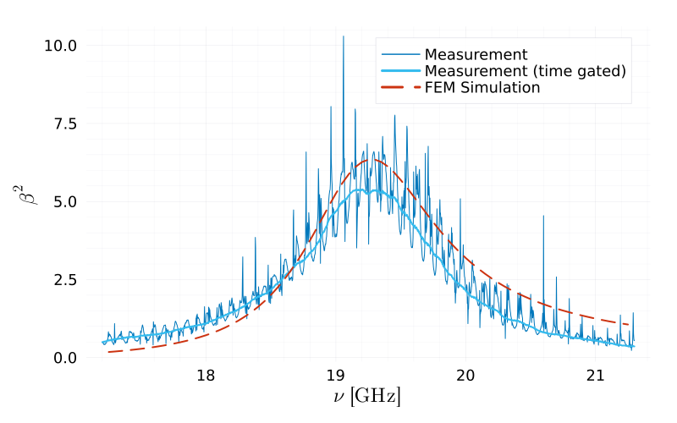
Signal Power
Measure max. E-field between disk and mirror
Calculate signal power
Includes effects currently
not simulated:
  Antenna coupling
  Transverse field perturbations
Single disk “low” boost factor
See poster by Jacob Egge

Slide 14
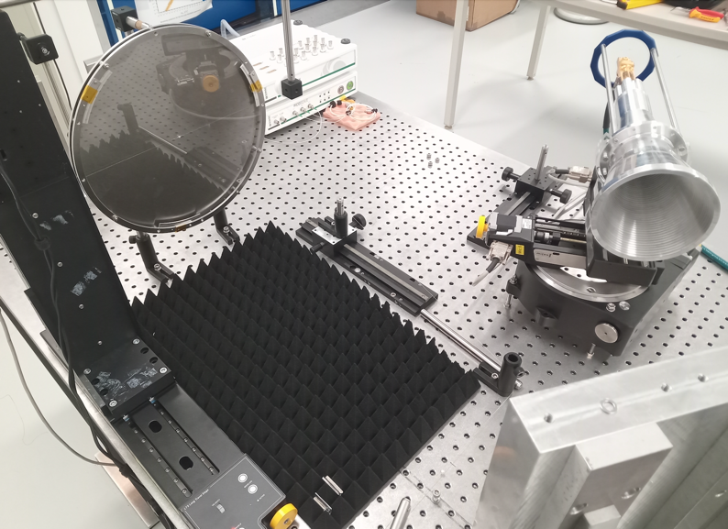
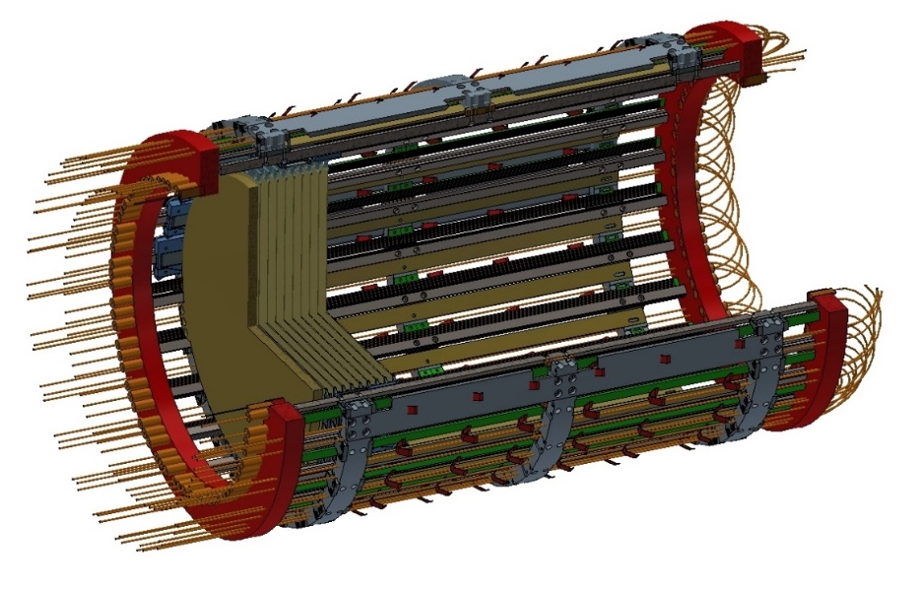
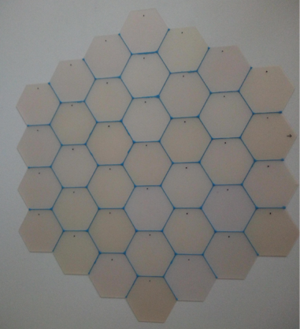
OB300: work in progress
Calibration of boost factor with 3 x ⌀ = 300 mm disks
Rails of disk drive system
Disks
Carriages
Tiling of ⌀ = 300 mm LaAlO₃ disks
Optical fibres
Laser interferometer couplers
Building mechanical structure for OB300

Slide 15

MADMAX Prototype
Manufactured by Bilfinger Noell GmbH
Two vacuum vessels:
- inner (4 K) cooled via LHe circulating through double-wall
- outer (isolation vacuum)
Closed-loop system with 4 cryocoolers for reliquification of LHe
➔ during operation: 50 l LHe
Delivery expected begining of 2024
Commissioning with OB300 in Hamburg mid 2024
MADMAX Prototype Cryostat (MPC)
LHe reservoir
& reliquifiers
Ø < 1.6 m
~3.3 m
~4.5 m
Receiver Cryostat (RC)

Slide 16

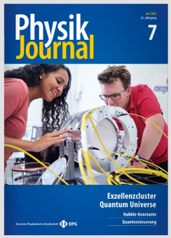
MADMAX Staged Program
2017
2018
2019
2020
2021
2022
2023
2024
2025
2026
2027
>= 2028
Design Phase
Prototyping Phase
Construction Phase
Foundation of
MADMAX
Collaboration
CB100
1.6 T, 295 K
CB100
1.6 T, 4 K
CB200
1.6 T, 295 K
DESY PRC
endorsement
OB300
295 K
OB300
4 K
OB300
1.6T, 4 K
Full-size MADMAX
commissioning
Usage of MORPURGO magnet approved
by CERN Research Board for 2021-2025

Slide 17
BACKUP

Slide 18
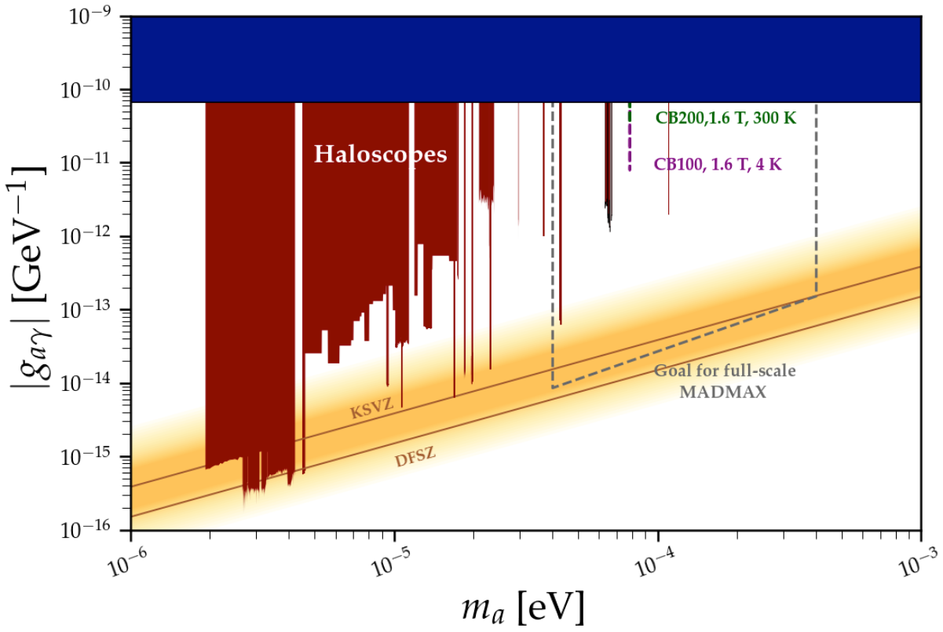
Coverage

Slide 19

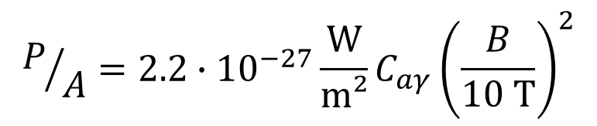
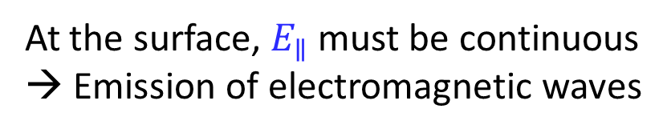
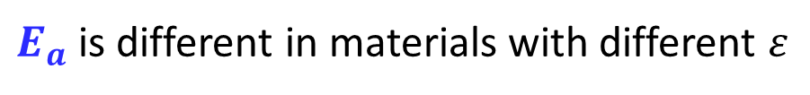
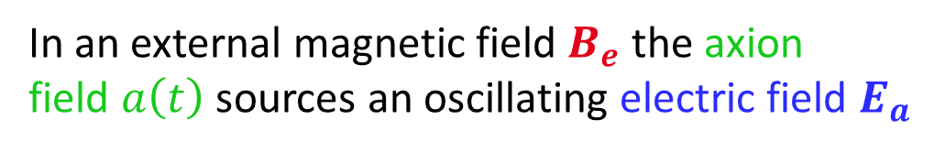
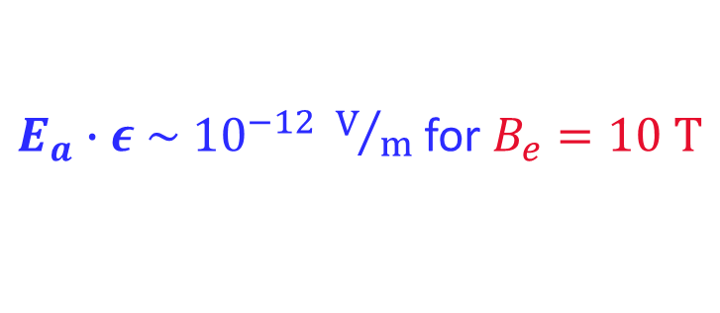
Dielectric Haloscope
In an external magnetic field $B_{e}$ the axion
field $a\left(t\right)$ sources an oscillating electric field $E_{a}$
$E_{a}∙ε \sim {10}^{−12} V/m$ for $B_{e}=10 T$
$E_{a}$ is different in materials with different $ε$
At the surface, $E_{∥}$ must be continuous
→ Emission of electromagnetic waves
$$P/A=2.2∙{10}^{−27}\frac{\text{W}}{\text{m}\text{²}}C_{aγ}{\left(\frac{B}{10 \text{T}}\right)}^{2}$$
$$𝒪(C_{aγ})=1$$
Power emitted from a single surface:

Slide 20
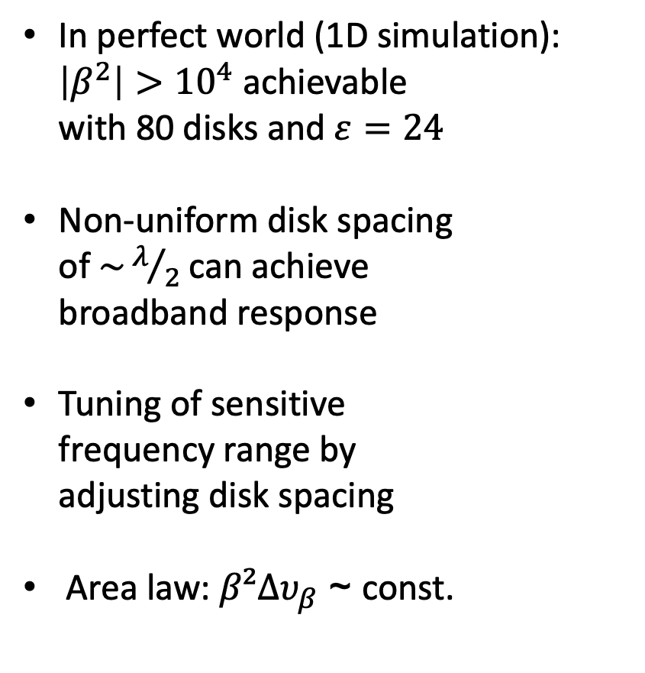

Dielectric Haloscope
In perfect world (1D simulation):
$\left|β^{2}\right|>{10}^{4}$ achievable
with 80 disks and $ε=24$
Non-uniform disk spacing
of $\sim λ/2$ can achieve
broadband response
Tuning of sensitive
frequency range by
adjusting disk spacing
Area law: $β²Δυ_{β}$ ~ const.
10⁵
Simulation
8 x 10⁴
6 x 10⁴
$$Δυ_{β}$$
4 x 10⁴
2 x 10⁴

Slide 21
The MADMAX Experiment
MAgnetized Disk and Mirror Axion eXperiment
Mirror (not visible)
9 T dipole magnet
~ 1 m
Cryostat (4 K)
Horn antenna & receiver system
Booster: adjustable dielectric disks (Ø~1.25 m)
[Eur. Phys. J. C 79 (2019) 186]
Focusing mirror

Slide 22
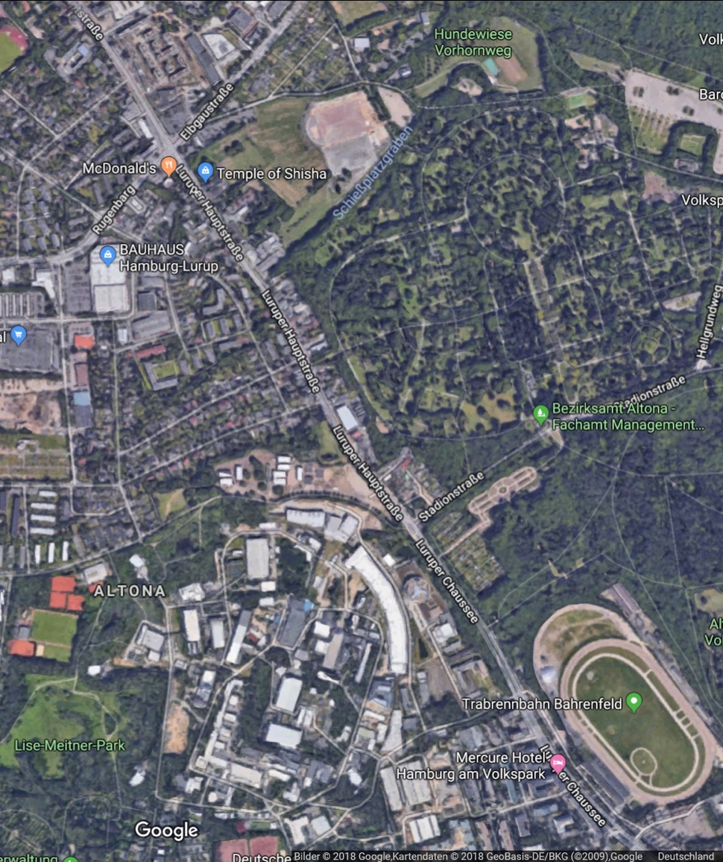
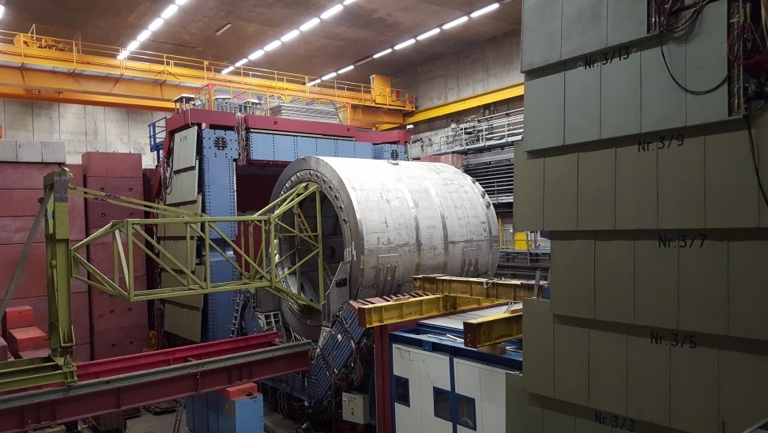
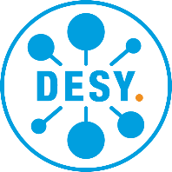
Designated Experimental Site
MADMAX to be operated at HERA Hall North
Make use of DESY infrastructure
→ Cryoplatform to be operational in 2025
Benefit: re-use H1 yoke as magnetic shielding
HERA Hall North
H1 yoke
H1 yoke
H1 magnet
(to be removed)
UHH
DESY

Slide 23
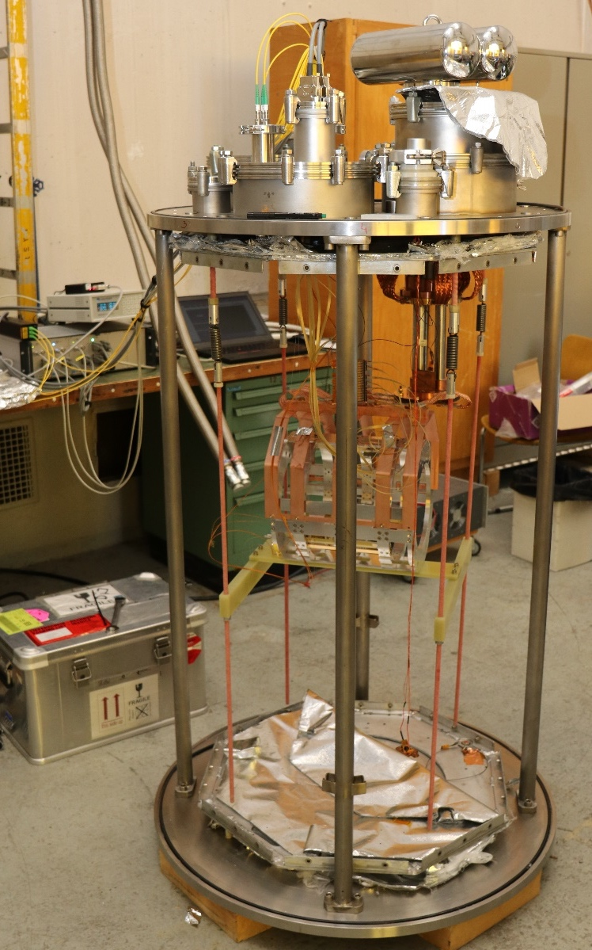
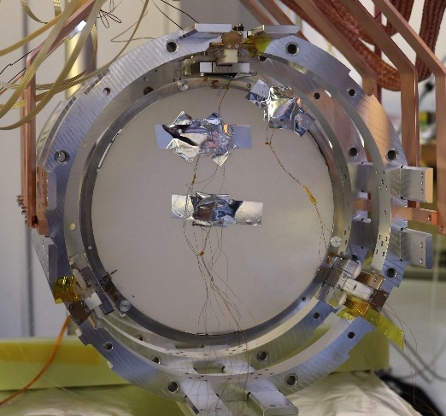

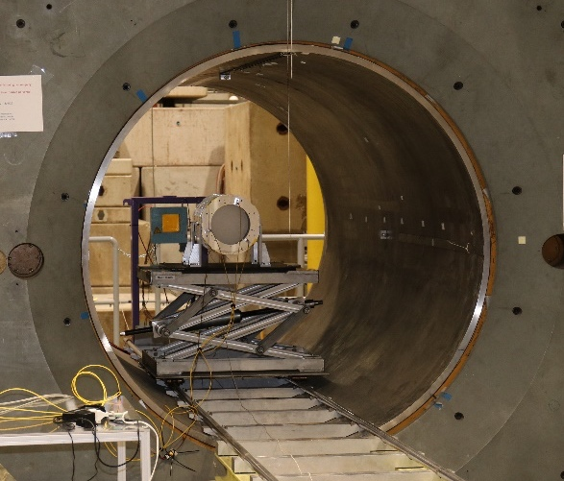
Testing the Disk Drive
Project200 successfully tested at CERN Cryolab and in CERN’s Morpurgo magnet
All three piezo motors work at cryogenic temperatures and in 1.6 T field (at RT)
Attocube laser interferometer works at cryogenic temperatures
Project200 backbone structure keeps optics alignment during cool-down
A disk can be moved with three motors using the laser interferometer feedback
No difference in disk velocity with/without B field
Project200 inside Morpurgo

Slide 24
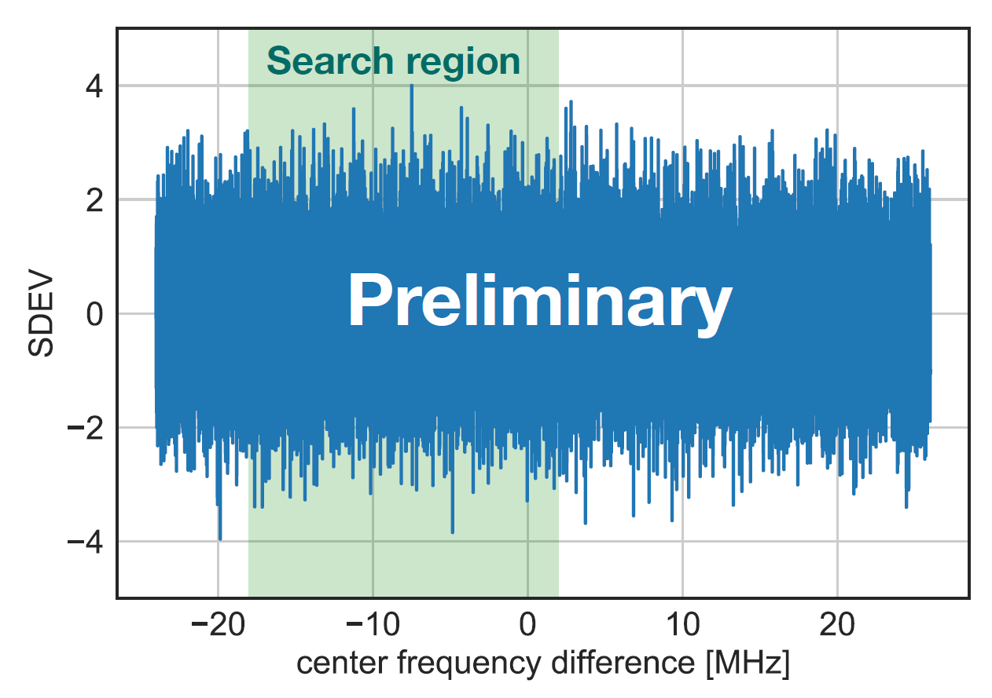

Axion Like Particle Search
Opportunity to perform ALP search in CERN’s Morpurgo magnet (1.6 T) was used in Mar/Apr 2022
In total 10 h at 1.6 T with ~ 200 K noise temperature
Sensitivity not dominated by RFI in CERN North Hall
Possibilities for an upgrade allowing to cool the setup to < 10 K in Morpurgo currently in preparation
DAQ system
Closed Booster 100
Projected sensitivity

Slide 25
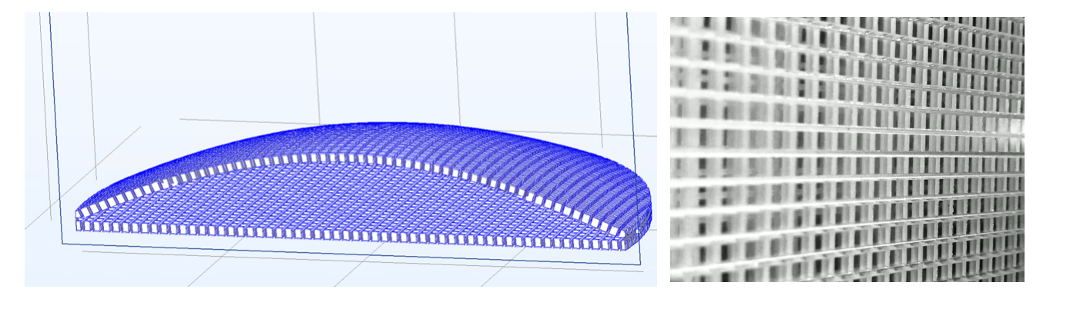
Dielectric Lens
Rexolite: dielectric constant = 2.53 and low loss
3d-printed and designed to mitigate reflection for our range of interest of ~18 to 20 GHz.
Contact: Anton Ivanov <ivanovan@mpp.mpg.de>

Slide 26

Receiver Chain
Down sampling:
20 GHz → 50 MHz
Samplers
Receiver chain with low-noise amplifier and three mixing stages
Amplifiers for high frequencies developed: TWPAs for < 30 GHz
Mixers & amps
Fake axion
injection
LNA
Test setup at MPP with 4 samplers and fake axion injection:
Detection of 1.2 x 10⁻²² W signal within few days
Low-noise cryogenic amplifier
(noise temperature 5 to 6 K)
Local oscillators (1 & 2)

Slide 27
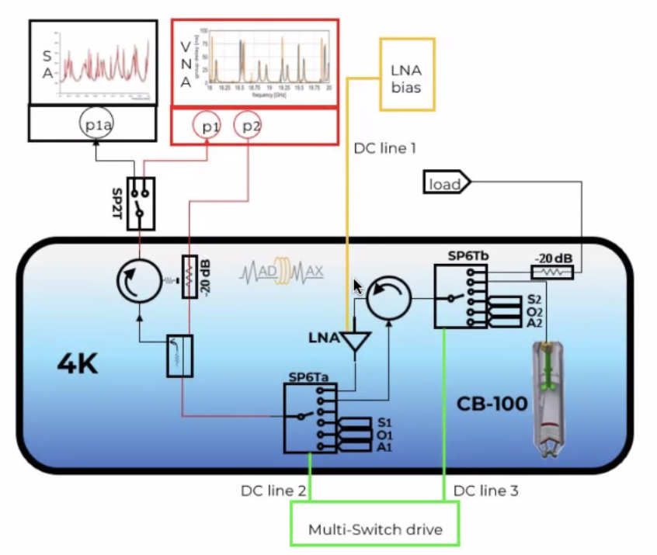
Cold Calibration Idea
Simulation still missing

Slide 28

Quantum-limited Amplifier
Traveling wave parametric amplifier (TWPA)
First 10 GHz TWPA produced (PRX 10, 021021)
Added noise: 1 K above quantum limit
(20 dB gain @ 10 GHz)
Future development to 30 GHz
[Reversed Kerr TWPA arXiv:2101.05815]

Slide 29
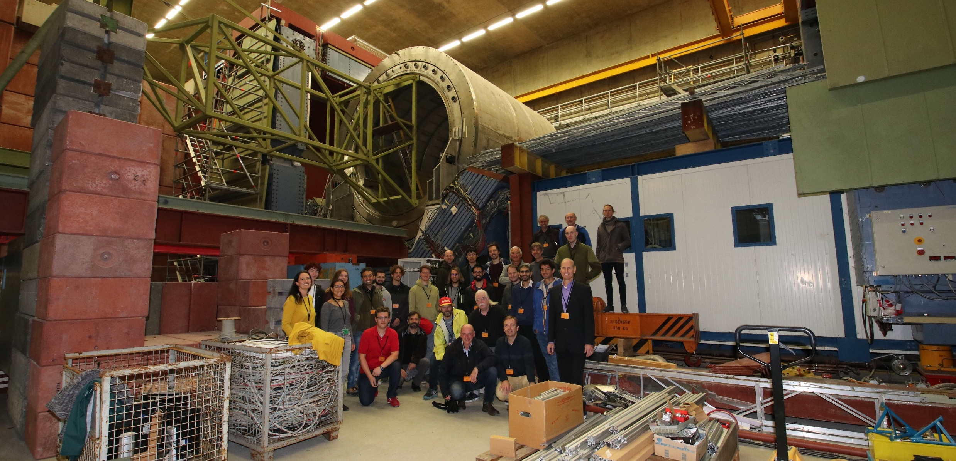
MADMAX Collaboration Meeting
September 2022 @ Hamburg

